Slide 1


Expanding The Base
Ruud Meulendijks
Coursera IBM Data Science Capstone Project

Slide 2
Introduction
The Base is an international restaurant located in the London Borough of Brent
The owners want to open up one or a couple of new restaurants in different London boroughs
The specific composition of the borough of Brent is a key business success factor
The new location(s) will have to be very similar to the borough of Brent
This analysis aims to find that places and present the owners with a couple of suitable boroughs in which to expand their business in

Slide 3
Business problem and target audience
Business Problem
Identifying boroughs in London which are very similar to the London borough of Brent, in order to provide the owners of The Base with a number of suitable areas to open up a new branch of the restaurant, with an optimal chance of success
Target audience
The principal stakeholders targeted, and most interested in the results of this analysis are of course the owners of the The Base brand

Slide 4
Data
Two sets of data are used in this analysis
One to get geographical data
The other for demograhic and other relevant borough data
Besides the datasets mentioned, Foursquare location data is leveraged to explore and compare the different London boroughs

Slide 5
Methodology
Importing necessary libraries
Importing, combining and cleaning datasets
Retrieving and processing Foursquare data
Analyzing each borough using all datasets including Foursquare data
Using K-means Clustering, clustering London boroughs
Determining cluster in which Brent is contained
Visualizing Brent’s cluster and presenting cluster information

Slide 6
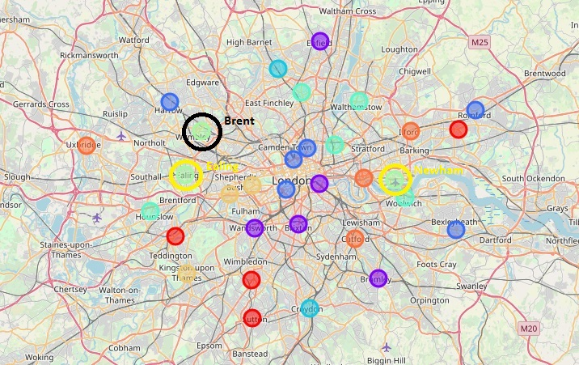
Results
Two boroughs are very similar to Brent: Ealing and Newham

Slide 7
Limitations
Only London was considered as a possible location for new branches of the restaurant
Some of the datasets provided data points which were more than five years old. That could be detrimental to the overall trustworthiness of that particular variables.
There has not been an extensive preparatory research into other possible significant location variables
The analysis does not identify the exact advisable location within the boroughs of Ealing and Newham
Location isn’t the only success factor for a restaurant

Slide 8
Conclusion
Having identified Ealing and Newham as two suitable locations to consider for new branches of The Base restaurant, and having advised the owners on limitation of the current analysis, the only thing left to do is wish the owners a lot of success with their expansion plan. I am looking forward to visiting Ealing and/or Newham for a delicious meal in the future!

Slide 9
THANK YOU

